Slide 1
Sequential Logic and Flip Flops

Slide 2
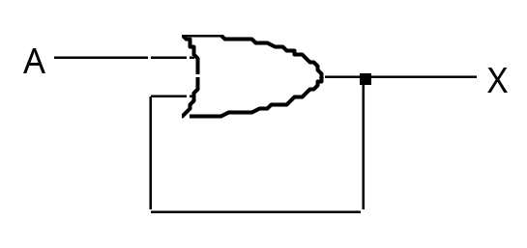
Sequential Logic Circuits
So far we have only considered circuits where the output is purely a function of the inputs
With sequential circuits the output is a function of the values of past and present inputs
This particular example is not very useful
X = X + A
Notes:
Examples of sequential circuits
A counter to count the number of times a signal has changed
A traffic light controller (remembering where it is up to in the sequence)

Slide 3
Latches and Flip Flops
Latches
  SR latch
  Clocked SR latch
  D Latch
Flip flops
  Master-slave
  Edge triggered
  JK

Slide 4
Sequential circuit concepts
The addition of a memory device to a combinational circuit allows the output to be fed back into the input:
circuit
Input(s)
Output(s)
memory
Introduction to Digital Electronics, Crowe and Hayes Gill, Newnes, ISBN0-340-64570-9

Slide 5
Synchronous and Asynchronous
circuit
Input(s)
Output(s)
memory
Clock pulse
With synchronous circuits a clock pulse is used to regulate the feedback, input signal only enabled when clock pulse is high – acts like a “gate” being opened.

Slide 6
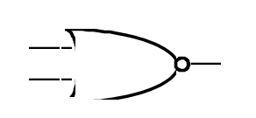
Latches
The SR Latch
  Consider the following circuit
R
Q
R
R
Q
Q
S
S
Q
Q
S
Q
Symbol
Circuit
R S Q_{n+1}
0 0 Q_{n}
0 1 1
1 0 0
1 1 ?
n+1 represents output at some future time
Function Table
n represents current output.
Notes:
Although SR LAtch is one of the most important fundamental methods of didgital storage,it is not often used in practice (because of undefined state) - However forms the basis of the more complex latches that we will be dicussing

Slide 7
SR Latch operation
Assume some previous operation has Q as a 1
Assume R and S are initially inactive
Indicates a stable state at some future time (n+ = now plus)
R = 0
Q = 1
R S Q_{n+1}
0 0 Q_{n}
0 1 1
1 0 0
1 1 ?
~Q = Q, ie is the complement of Q.
S = 0
Q = 0
Circuit
Now assume R goes first to 1 then returns to 0, what happens:

Slide 8
Reset goes active
R = 1
When R goes active 1, the output from the first gate must be 0.
Q = 0
This 0 feeds
back to gate 2
S = 0
~Q = 1
Since both inputs are 0 the output is forced to 1
The output ~Q is fed back to gate 1, both inputs being 1 the output Q stays at 0.
R = 1
Q = 0
S = 0
~Q = 1

Slide 9
Reset goes in-active
R = 0
Q = 0
When R now goes in-active 0, the feedback from ~Q (still 1), holds Q at 0.
S = 0
~Q = 1
The “pulse” in R has changed the output as shown in the function table:
R S Q_{n+1}
0 0 Q_{n}
0 1 1
1 0 0
1 1 ?
We went from here
To here
And back again
In that process, Q changed from 1 to 0. Further signals on R will have no effect.

Slide 10
Set the latch
Similar sequences can be followed to show that setting S to 1 then 0 – activating S – will set Q to a 1 stable state.
When R and S are activated simultaneously both outputs will go to a 0
R = 1
Q = 0
S = 1
~Q = 0
When R and S now go inactive 0, both inputs at both gates are 0 and both gates output a 1.
This 1 fedback to the inputs drives the outputs to 0, again both inputs are 0 and so on and so on and so on and so on.

Slide 11
Metastable state
In a perfect world of perfect electronic circuits the oscillation continues indefinitely.
However, delays will not be consistent in both gates so the circuit will collapse into one stable state or another.
R S Q_{n+1}
0 0 Q_{n}
0 1 1
1 0 0
1 1 ?
This collapse is unpredictable.
Thus our function table:
Future output = present output
Set the latch
Reset the latch
Don’t know

Slide 12
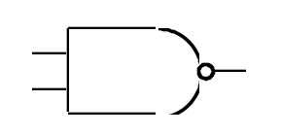
Latches
The SR Latch
  NAND Form produces similar result from inverted inputs
R
Q
R S Q_{n+1}
0 0 ?
0 1 0
1 0 1
1 1 Q_{n}
R
R
Q
Q
S
Q
S
S
Q
Q
Circuit
Symbol
Function Table
You ought to be able to figure this one out yourself!

Slide 13
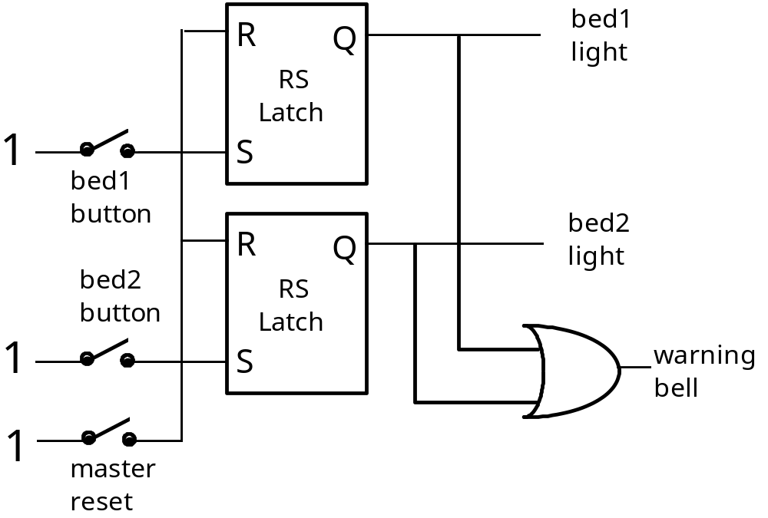
Application of the SR Latch
  An important application of SR latches is for recording short lived events
    e.g. pressing an alarm bell in a hospital

Slide 14
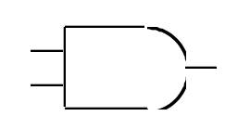
The Clocked SR Latch
In some cases it is necessary to disable the inputs to a latch
This can be achieved by adding a control or clock input to the latch
  When C = 0 R and S inputs cannot reach the latch
    Holds its stored value
  When C = 1 R and S inputs connected to the latch
    Functions as before
R
Q
C
Q
S

Slide 15
Clocked SR Latch
R S C Q_{n+1}
X X 0 Q_{n} Hold
0 0 1 Q_{n} Hold
0 1 1 1 Set
1 0 1 0 Reset
1 1 1 ? Unused
R
R
Q
Q
C
C
S
S
Q
Q

Slide 16
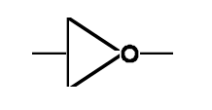
Clocked D Latch
Simplest clocked latch of practical importance is the Clocked D latch
D
S
Q
C
Q
R
  It means that both active 1 inputs at R and S can’t occur.
  Notice we’ve reversed S and R so when D is 1 Q is 1.

Slide 17
D Latch
    It removes the undefined behaviour of the SR latch
    Often used as a basic memory element for the short term storage of a binary digit applied to its input
    Symbols are often labeled data and enable/clock (D and C)
D
Q
S
Q
D
Q
D C Q_{n+1}
X 0 Q_{n} Hold
0 1 0 Reset
1 1 1 Set
C
C
C
Q
R
Q
Q
Circuit
Symbol
Function Table

Slide 18
Transparency
  The devices that we have looked so far are transparent
    That is when C = 1 the output follows the input
    There will be a slight lag between them
t
Notes:
Analogous to:
- opening a shutter to let light through a window (except when shutter closed light does not remain at level just before it closed)
- Locks in a dam a better example
C
D
Q
0
1
0
1
0
1
t
t
t

Slide 19
Propagation Delay, set-up and hold
(for transparent circuits)
Propagation delay:
Time taken for any change at inputs to affect outputs (change on D to change on Q).
Setup time:
Data on inputs D must be held steady for at least this time before the clock changes.
Hold time:
Data on inputs D must be held steady for at least this time after the clock changes.

Slide 20
Latches - Summary
Two cross-coupled NOR gates form an SR (set and reset) latch
A clocked SR latch has an additional input that controls when setting and resetting can take place
A D latch has a single data input
  the output is held when the clock input is a zero
  the input is copied to the output when the clock input is a one
The output of the clocked latches is transparent
The output of the clocked D latch can be represented by the following behaviour
D C Q_{n+1}
X 0 Q_{n} Hold
0 1 0 Reset
1 1 1 Set

Slide 21
Latches and Flip Flops
Terms are sometimes used confusingly:
A latch is not clocked whereas a flip-flop is clocked.
A clocked latch can therefore equally be referred to as a flip flop (SR flip flop, D flip flop).
However, as we shall see, all practical flip flops are edge-triggered on the clock pulse.
Sometimes latches are included within flip flops as a sub-type.

Slide 22
Latches and Flip Flops
Clocked latches are level triggered. While the clock is high, inputs and thus outputs can change.
This is not always desirable.
A Flip Flop is edge-triggered – either by the leading or falling edge of the clock pulse.
Ideally, it responds to the inputs only at a particular instant in time.
It is not transparent.

Slide 23
D-type Latch – Timing Review
D
S
Q
C
Q
R
1
C
The high part represents active 1, the low part active 0.
0
t
1
D
0
t
1
Q
0
t

Slide 24
Master Slave D Flip-flop
A negative edge triggered flip-flop
Master
Slave
D
Y
D
Q
C
C
Q
On the negative edge of the clock, the master captures the D input and the slave outputs it.

Slide 25
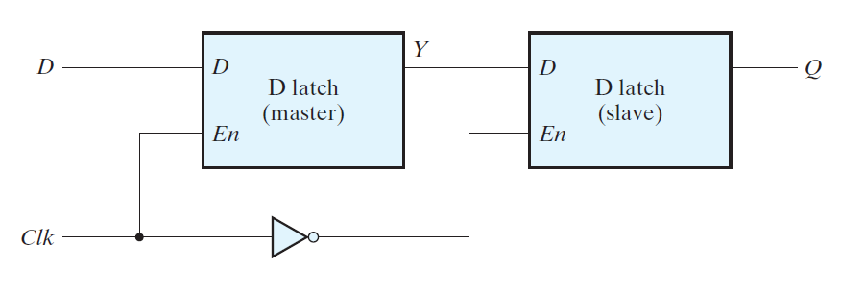
D Flip-Flop: Master-Slave
ECE 301 - Digital Electronics

Slide 26
The master-slave Flip-flop
Master
Slave
D
P
Q
P
Q
C
No matter how long the clock pulse, both circuits cannot be active at the same time.
Notes:
When C = 1 output of master (P) follows D input and because of inverted C input output of master unable to influence output of slave
When C = 1->0 master slave output influenced by master output - note masters inputs disabled at this time (i.e. Value of D just before negative clock edge copied to Q output - a negative edge triggered device)
Because of master-slave behaviour transparency removed
***** ATTENTION, Q and Q-bar in figure wrong way around.

Slide 27
JK Flip-flop
J
Q
The most versatile of the flip-flops
Has two data inputs (J and K)
Do not have an undefined state like SR flip-flops
  When J & K both equal 1 the output toggles on the active clock edge
Most JK flip-flops based on the edge-triggered principle
K
Q
+ve edge triggered
JK flip-flop
J K C Q_{n+1}
0 0 ↑ Q_{n} Hold
0 1 ↑ 0 Reset
1 0 ↑ 1 Set
1 1 ↑ Q_{n} Toggle
X X X Q_{n} Hold
    The C column indicates +ve edge triggering (usually omitted)
Notes:
Talk about symbols for +ve and -ve edge-triggered flip flops
Master-slave version susceptible

Slide 28
Example JK circuit
J
Q
A
C
E
Ck
F
B
D
K
~Q
J K C Q_{n+1}
0 0 ↑ Q_{n} Hold
0 1 ↑ 0 Reset
1 0 ↑ 1 Set
1 1 ↑ Q_{n} Toggle
X X X Q_{n} Hold

Slide 29
Timing diagram for JK Flip-flop
Negative Edge Triggered
clock
J
K
Q
toggle
J=K=1
hold
J=K=0
reset
J= 0 K=1
set
J= 1 K=0

Slide 30
Clock Pulse
The JK flip flop seems to solve all the problems associated with both inputs at 1.
However the clock rise/fall is of finite duration.
If the clock pulse takes long enough, the circuit can toggle.
For the JK flip flop it is assumed the pulse is quick enough for the circuit to change only once.
ideal / actual edge pulse

Slide 31
JK from D Flip-flop
J
D
Q
K
CLK
C
Q’

Slide 32
Summary
Flip flops are circuits controlled by a clock.
Triggered on the edge of the pulse to avoid races with both inputs at 1 during the clock pulse.
Because modern ic’s have a small propagation delay races can still occur.
The master-slave configuration solves this problem by having only master or slave active at any one time.

Slide 33
What you should be able to do
Explain the difference between combinational and sequential circuits
Explain the basic operation of SR and D latches.
Explain the operation of SR and JK flip flops.
Explain the operation of master-slave flip flops.

